Slide 1
Class 6 NAFTA and Its Renegotiation as USMCA
PubPol 201
Module 3: International Trade Policy

Slide 2
Class 6 Outline
NAFTA and Its Renegotiation as USMCA
What is NAFTA?
What happened under NAFTA?
Issues in renegotiation
USMCA

Slide 3
Class 6 Outline
NAFTA and Its Renegotiation as USMCA
What is NAFTA?
What happened under NAFTA?
Issues in renegotiation
USMCA

Slide 4
NAFTA – What is it?
NAFTA
USMCA
“The single worst trade deal ever approved in this country” Donald Trump 2016
“A wonderful new trade deal” & “the most important trade deal we’ve ever made, by far” Donald Trump 2018

Slide 5
NAFTA – What is it?
A Free Trade Agreement (FTA) including US, Canada, and Mexico
Expanded a previous US-Canada FTA
Negotiated under President George H. W. Bush
Enacted 1993 under President Bill Clinton
Went into effect Jan 1, 1994

Slide 6
NAFTA – What is it?
FTA provisions:
Zero tariffs on imports from each other
Doesn’t change tariffs on outside countries
Rules of origin
Goods cross borders tariff-free only if they “originate” in the NAFTA countries
”Originate” defined in terms of how much of a good was produced here
Example: Autos require 62.5% North American content

Slide 7
NAFTA – What is it?
Other provisions
Some liberalization in services
Foreign investment
ISDS in Chapter 11
Gives foreign investors right to dispute policies that reduce profits
Decided by 3-person panel, who may make states pay
Intellectual property rights
Opening of government procurement
Governments must let NAFTA suppliers bid

Slide 8
NAFTA – What is it?
Also Side Agreements on
Labor
Environment

Slide 9
Class 6 Outline
NAFTA and Its Renegotiation as USMCA
What is NAFTA?
What happened under NAFTA?
Issues in renegotiation
USMCA

Slide 10
NAFTA - What happened?
What happened?
Not much, at first, in 1994
Mexico kept peso pegged to the dollar
Resisted devaluing peso in run-up to presidential election
Assassinations in 1994 included
Mar 23: PRI presidential candidate Colosio

Slide 11
NAFTA - What happened?
Peso Crisis (aka “Tequila Crisis”)
December 20, 1994 (after the election)
Crisis hit the foreign exchange market
Mexico devalued the peso
Devaluation had devastating effects on the Mexican economy
Mexico had borrowed in dollars to pay for assets in pesos
Devaluation meant that debt was suddenly higher than assets for many

Slide 12
Reserves Fell at Once
What Happened: Mexico
NAFTA
Peso Crisis

Slide 13
What Happened: Mexico
Peso Dropped One Year After
NAFTA
Mexico Exchange Rate
Peso Crisis
Quarterly 1988-2004
0.5
0.4
$/peso
0.3
0.2
0.1
0
Q1 1988
Q2 1989
Q3 1990
Q4 1991
Q1 1993
Q2 1994
Q3 1995
Q4 1996
Q1 1998
Q2 1999
Q3 2000
Q4 2001
Q1 2003
Q2 2004
Notes:
Source of data in slide and following: IMF IFS online

Slide 14
GDP Fell after Peso Crisis
What Happened: Mexico
NAFTA
Mexico Real GDP
Peso Crisis
1993=100
160
140
120
100
80
60
40
20
0
Q1 1988
Q2 1989
Q3 1990
Q4 1991
Q1 1993
Q2 1994
Q3 1995
Q4 1996
Q1 1998
Q2 1999
Q3 2000
Q4 2001
Q1 2003
Q2 2004

Slide 15
Imports Fell after Crisis; Exports Rose
What Happened: Mexico
NAFTA
Peso Crisis

Slide 16
Wages Fell
What Happened: Mexico
NAFTA
Peso Crisis

Slide 17
Real Wages Plummeted!
What Happened: Mexico
NAFTA
Peso Crisis

Slide 18
Unemployment: No effect (or fell)
What Happened: U.S.
NAFTA
Peso Crisis

Slide 19
Trade: Continued growth
What Happened: U.S.
NAFTA
Peso Crisis
Deficit started to grow more in 1998

Slide 20
Real Wage: No Change
What Happened: U.S.
NAFTA
Peso Crisis

Slide 21
Grew: But more To US than From
What Happened: Bilateral Trade
NAFTA
Peso Crisis

Slide 22
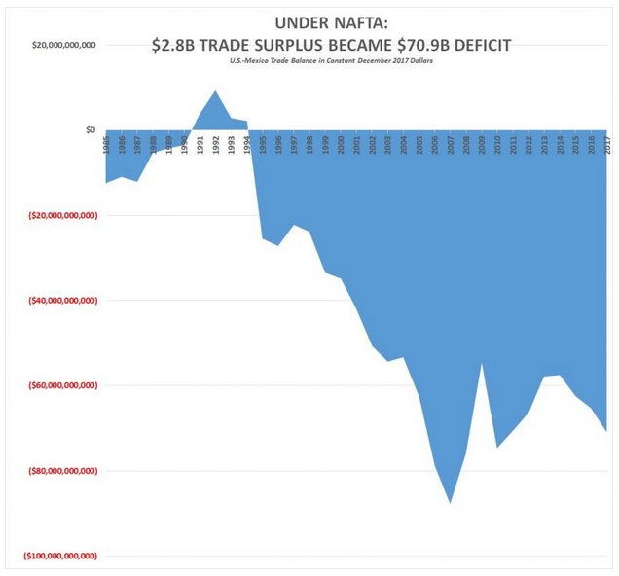
NAFTA
Notes:
https://www.cnsnews.com/news/article/terence-p-jeffrey/under-nafta-28b-us-mexico-trade-surplus-became-71b-deficit

Slide 23
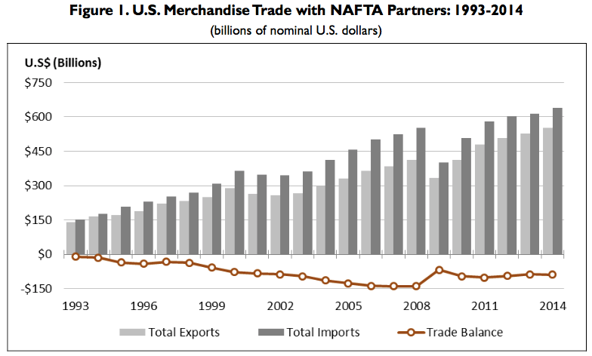
Source: Congressional Research Service (2015)

Slide 24
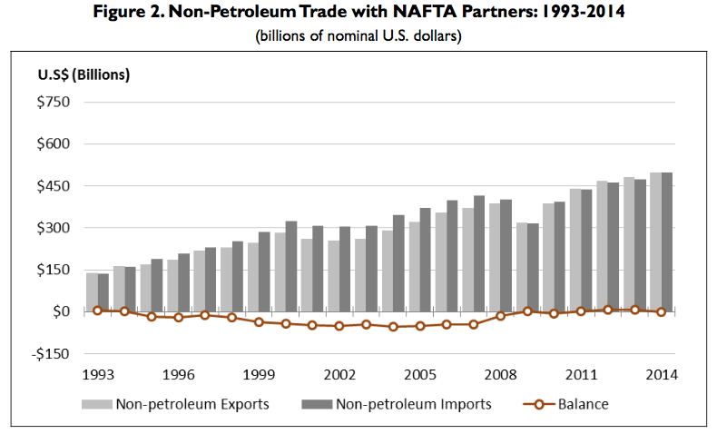
Source: Congressional Research Service (2015)

Slide 25
Supply Chains
Much of the growth of trade within NAFTA has been supply chains
Final goods are produced in one country with inputs from another
Inputs are in turn produced with inputs from yet another
And so forth
Supply chains in much of manufacturing now cross the two borders many times

Slide 26
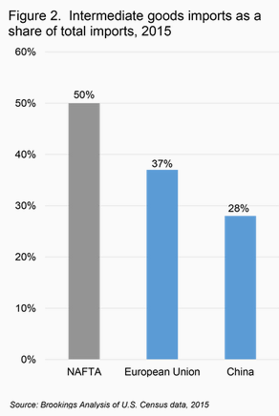
Notes:
https://www.brookings.edu/blog/the-avenue/2017/03/30/how-u-s-states-rely-on-the-nafta-supply-chain/

Slide 27
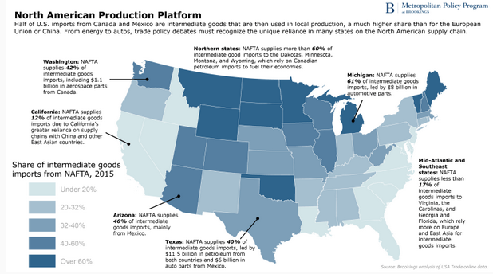
Notes:
https://www.brookings.edu/blog/the-avenue/2017/03/30/how-u-s-states-rely-on-the-nafta-supply-chain/

Slide 28
NAFTA Analyses
Posen (2014)
“For every 100 jobs US manufacturers created in Mexican manufacturing, they added nearly 250 jobs at their larger US home operations”
Unemployment in US was actually lower after NAFTA than before (until the 2008 financial crisis)
Critics say NAFTA cost 45,000 jobs a year.
That may be true
But this is only 0.1% of normal job turnover in the US, where 4m-6m workers leave or lose jobs per month)

Slide 29
NAFTA Analyses
Hakobyan and McLaren (2016)
They look for effects on local labor markets, where
industries
and/or communities
were vulnerable to large tariff cuts against Mexico
They find
Substantial variation across localities

Slide 30
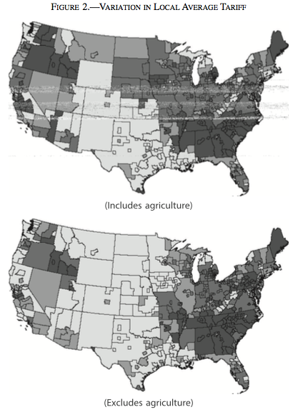
Source: Hakobyan and McLaren (2016)

Slide 31
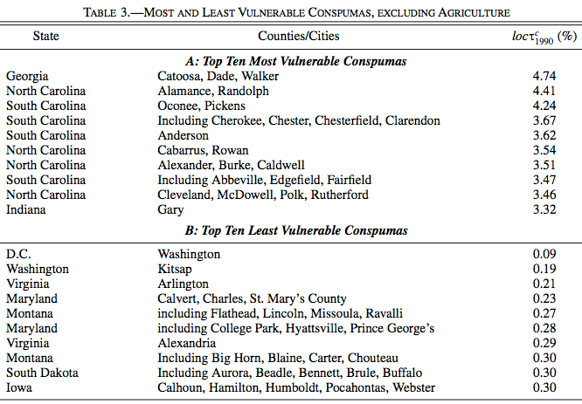
(Consistent Public-Use Microdata Areas)
Source: Hakobyan and McLaren (2016)

Slide 32
NAFTA Analyses
Hakobyan and McLaren (2016)
“…even workers in a nontraded industry—waiting on tables in a diner, for example—saw a sharp reduction in wages if they were in a vulnerable location that lost its protection quickly.”

Slide 33
NAFTA Analyses
Disruption of some industries and localities
Some was expected
May have been larger than expected
Has not been dealt with adequately by TAA
Nonetheless was still small
But provides easy ammunition for critics

Slide 34
Discussion Question
Do you know anybody who was hurt by NAFTA?
Do you know anybody who was helped by NAFTA?

Slide 35
Class 6 Outline
NAFTA and Its Renegotiation as USMCA
What is NAFTA?
What happened under NAFTA?
Issues in renegotiation
USMCA

Slide 36
Issues in the Renegotiation
Issues (US)
Trade imbalances
Reciprocal duty-free market access
Rules of origin
Regulations
Services
Digital trade
ISDS
State-owned enterprises
Labor standards
Chapter 19
Procurement
Currency manipulation

Slide 37
Issues in the Renegotiation
Too many to discuss them all
The following are just some of the more important and/or interesting

Slide 38
Issues in the Renegotiation
Trade imbalances
The US top priority is to “Improve the U.S. trade balance and reduce the trade deficit with the NAFTA countries.”
That is not something that can itself be written into the NAFTA agreement
So the question will be which changes in the agreement might do this
One possibility is a “trigger mechanism” that raises tariffs if goal of reducing deficit is not met

Slide 39
Issues in the Renegotiation
Reciprocal duty-free market access
The stated intent of the US is to “maintain” this “while taking into account U.S. import sensitivities”
Top objectives of both Mexico and Canada are to avoid any increases in US tariffs
Perhaps some of the few positive barriers that continue under NAFTA will be removed.

Slide 40
Issues in the Renegotiation
Rules of origin
The TPP would have reduced the requirement for North American (N-A) content in autos from 62.5% to below 50%.
The new NAFTA will almost certainly increase this requirement for autos and other products
The question will be: how much, and how disruptive will it be
If too high, some producers will revert to sourcing from outside NAFTA
Lighthizer wants “higher NAFTA content and substantial American content”. That would be unprecedented in an FTA

Slide 41
Issues in the Renegotiation
Digital trade
Digital trade (& e-commerce) did not exist in 1993, and was not covered
All parties seem to agree that new rules should stop governments from placing restrictions on such trade
The TPP included this, and it may be copied here

Slide 42
Issues in the Renegotiation
ISDS = Investor-State Dispute Settlement (Chapter 11 of NAFTA)
“While the U.S. has so far never lost an ISDS case, both Canada and Mexico have lost several, requiring payments to investors of over $100 million.” (From Gertz, Mar 2017)
Big corporations want this retained
Others want it weakened or removed
Notes:
Gertz, 2017, https://www.brookings.edu/wp-content/uploads/2017/03/global-20170315-nafta.pdf

Slide 43
Issues in the Renegotiation
ISDS
USTR calls for
“rules that reduce or eliminate barriers to U.S. investment” (Is that pro-ISDS?)
“ensuring that NAFTA country investors in the United States are not accorded greater substantive rights than domestic investors” (Is that anti-ISDS)
(Perhaps he wants ISDS for US companies but not for foreign companies)

Slide 44
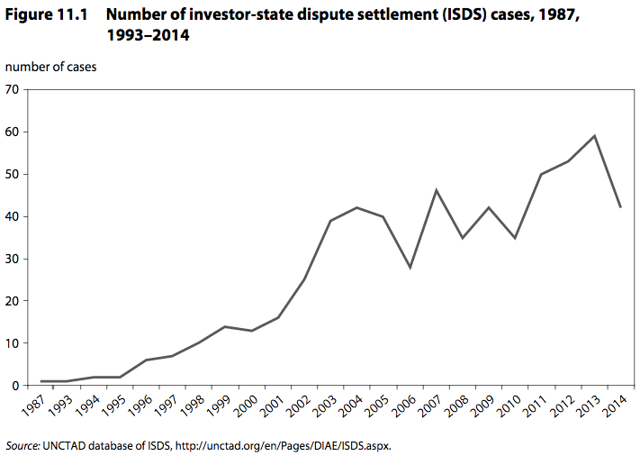
(Not just NAFTA)
Notes:
https://piie.com/publications/chapters_preview/7137/11iie7137.pdf

Slide 45
Issues in the Renegotiation
Chapter 19
This now allows NAFTA countries an appeal against AD & CVD actions
Canada insists on keeping it
US wants it removed
You can see why from the data below

Slide 46
Notes:
See Chapter 19.xls
From NAFTA Chapter 19 Binational Panel Decisions
WorldTradeLaw.net
http://www.worldtradelaw.net/databases/nafta19.php

Slide 47
Notes:
See Chapter 19.xls
From NAFTA Chapter 19 Binational Panel Decisions
WorldTradeLaw.net
http://www.worldtradelaw.net/databases/nafta19.php

Slide 48
Issues in the Renegotiation
Procurement
NAFTA currently required governments to open procurement to suppliers from all NAFTA countries
US wants to allow governments a preference for their own suppliers (“Buy American”)
US might even ask for all three governments to give preference to US suppliers, not their own!

Slide 49
Issues in the Renegotiation
Currency manipulation
This seems an odd thing to include in NAFTA, since nobody has accused either Mexico or Canada of doing it
Intent is probably to have it (for the first time in an FTA) as a template for later FTAs with, say, Japan or China

Slide 50
Issues in the Renegotiation
Dairy & poultry
Canada wants to keep its “supply management system for dairy and poultry”
Supply management allows farmers to act collectively to manage supply and price
Canada has a 270% tariff on dairy imports (with a small quota tariff-free)
This was exempted from liberalization in NAFTA

Slide 51
Class 6 Outline
NAFTA and Its Renegotiation as USMCA
What is NAFTA?
What happened under NAFTA?
Issues in renegotiation
USMCA

Slide 52
USMCA
Outcome of the Renegotiation
May 18, 2017: Renegotiation began
Aug 27, 2018: Agreement reached between US and Mexico
Sep 30, 2018: Agreement reached with Canada to join USMCA

Slide 53
USMCA
Features of USMCA
Auto rules of origin
Required North American content raised from 62.5% to 75%
40-45% content must be from labor paid $15/hr or more (but does not rise with inflation)

Slide 54
USMCA
Features of USMCA
New rules (similar to TPP) on
Intellectual property
Environment
Labor
Financial services
Digital trade

Slide 55
USMCA
Features of USMCA
Sunset clause? Not exactly
Revisit deal after 6 years
If happy, extend for 10 more
If not, new negotiations

Slide 56
USMCA
Features of USMCA
Canadian dairy
Canada will increase permitted imports of dairy from US, to 3.6% of its market
Canada to cease selling some dairy ingredients abroad and low prices and will tax exports over over some threshold

Slide 57
USMCA
Features of USMCA
Currencies
Commitment to “refrain from competitive devaluations and targeting exchange rates”

Slide 58
USMCA
Features of USMCA
Trade with China
Countries must inform US 3 months before beginning trade negotiations with any “non-market economy” (i.e., China)
If agreement with such economy is reached, US can terminate USMCA with six months notice.

Slide 59
USMCA
Features of USMCA
Chapter 19
Keeps this dispute settlement system for trade remedies such as anti-dumping
Does not apply them to “national-security-based” tariffs

Slide 60
USMCA
Features of USMCA
Chapter 11 (ISDS)
Removes this for disputes between US and Canada
Keeps it for disputes with Mexico

Slide 61
USMCA
“Side letter” of USMCA
Promise to shield Canada Mexico from future “national-security-based” tariffs (i.e., cars) (not enforceable)

Slide 62
USMCA
NOT a Feature of USMCA
Removal of US recent tariffs on steel and aluminum from Canada and Mexico

Slide 63
USMCA
Prospects for approval
Must be approved by all three legislatures
Canada: Dairy will resist, but approval assures
Mexico: Incoming President wants it done
US: Contentious, but best hope is approval in lame-duck session

Slide 64
USMCA
Importance of USMCA
Trump: “It’s not NAFTA redone, it’s a brand-new deal”
NYT: “a consequential set of revisions”
Economist: “a modest revision”, “inferior to the agreement it replaces”
Bown: deal to “result in less trade, not more”

Slide 65
Discussion Question
Who would you say “won” and “lost” from the NAFTA renegotiation?

